Slide 1
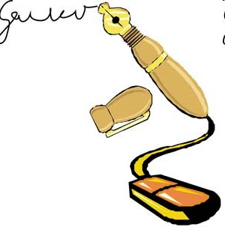
Digital Signature

Slide 2
CAT II Portion
Unit - III:
Asymmetric key cryptographic techniques: principles
RSA
ElGamal
Elliptic Curve cryptography
Secret Sharing, Key distribution and Key exchange protocols
Diffie-Hellman Key Exchange, Man-in-the-Meddle Attack
Unit - IV:
Requirements for Hash Functions
Security of Hash Functions
Message Digest (MD5)
Secure Hash Function (SHA 512)
Birthday Attack,
HMAC
Unit – V:
Authentication Requirements
Authentication Functions
Message Authentication Codes,
Digital Signature Authentication
Authentication Protocols
Digital Signature Standards,
RSA Digital Signature
Elgamal based Digital Signature,

Slide 3

Overview
Digital Signatures
ElGamal Digital Signature Scheme
Digital Signature Standard (DSS)
These slides are based partly on Lawrie Brown’s slides supplied with William Stallings’s book “Cryptography and Network Security: Principles and Practice,” 6th Ed, 2013.

Slide 4
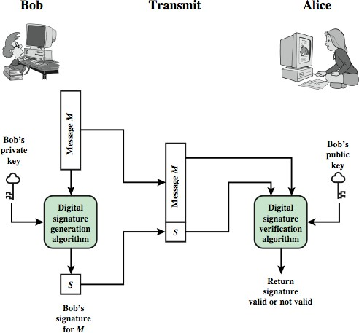
Digital Signatures
Verify author, date & time of signature
Authenticate message contents
Can be verified by third parties to resolve disputes

Slide 5
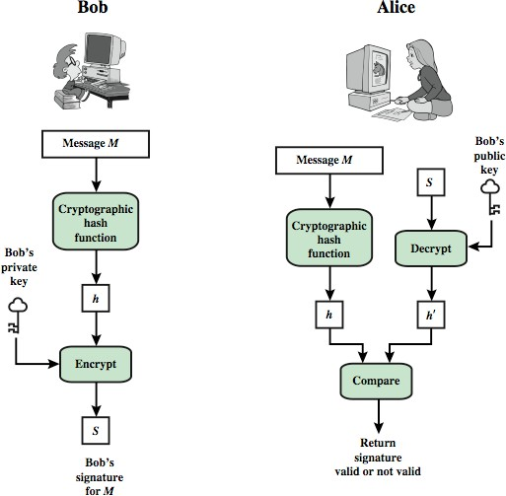
Digital Signature Model

Slide 6
Attacks
In the order of Increasing severity.
C=Attacker, A=Victim
Key-only attack: C only knows A’s public key
Known message attack: C has a set of messages, signatures
Generic chosen message attack: C obtains A’s signatures on messages selected without knowledge of A’s public key
Directed chosen message attack: C obtains A’s signatures on messages selected after knowing A’s public key
Adaptive chosen message attack: C may request signatures on messages depending upon previous message-signature pairs

Slide 7
Forgeries
Total break: C knows A’s private key
Universal forgery: C can generate A’s signatures on any message
Selective forgery: C can generate A’s signature for a particular message chosen by C
Existential forgery: C can generate A’s signature for a message not chosen by C

Slide 8
Digital Signature Requirements
Must depend on the message signed
Must use information unique to sender
To prevent both forgery and denial
Must be relatively easy to produce
Must be relatively easy to recognize & verify Directed ⇒ Recipient can verify
Arbitrated ⇒ Anyone can verify
Be computationally infeasible to forge
With new message for existing digital signature
With fraudulent digital signature for given message
Be able to retain a copy of the signature in storage

Slide 9
ElGamal Digital Signatures
Signature variant of ElGamal, related to D-H
Uses exponentiation in a finite (Galois) field
Based on difficulty of computing discrete logarithms, as in D-H
Each user (e.g., A) generates his/her key
Given a large prime q and its primitive root a
A chooses a private key: 1 < x_{A} < q-1
A computes his public key: y = a^{xA} mod q
A
Ref: http://en.wikipedia.org/wiki/ElGamal_signature_scheme

Slide 10
ElGamal Digital Signature
Alice signs a message M to Bob by computing
Hash m = H(M), 0 <= m <= (q-1)
Choose random integer K with 1 <= K <= (q-1) and
gcd(K,q-1)=1 (K is the per message key)
K
Compute S₁ = a mod q
Compute K⁻¹ the inverse of K mod (q-1)
Compute the value: S₂ = K⁻¹(m-x_{A}S₁) mod (q-1)
If S₂ is zero, start with a new k
Signature is:(S₁,S₂)
Any user B can verify the signature by computing
V₁ = a mod q
m
V₂ = y ^{S1}
_{S} S2
mod q
A 1
Signature is valid if V₂ = V₁
(a^{xA} )^{S1 ¡}a^{K ¢S2}
_{= a}x_{A} S₁+KS_{2 = a}x_{A}S₁+m−x_{A} S₁
= a^{m}

Slide 11
ElGamal Signature Example
GF(19) q=19 and a=10
Alice computes her key:
16
A chooses x_{A}=16 & computes y_{A}=10 mod 19 = 4
Alice signs message with hash m=14 as (3,4):
Choosing random K=5 which has gcd(18,5)=1
5
Computing S₁ = 10 mod 19 = 3
Finding K⁻¹ mod (q-1) = 5⁻¹ mod 18 = 11
Computing S₂ = 11(14-16🞨3) mod 18 = 4
Any user B can verify the signature by computing
V = a^{m} mod q = 10¹⁴ mod 19 = 16
1
V₂ =y ^{S1}S ^{S2}modq=4³3^{4 mod 19}
= 5184 mod 19 = 16
A 1
Since 16 = 16 signature is valid

Slide 12
Digital Signature Standard (DSS)
US Govt approved signature scheme
Designed by NIST & NSA in early 90's
Published as FIPS-186 in 1991
Revised in 1993, 1996 & then 2000
Uses the SHA hash algorithm
DSS is the standard, DSA is the algorithm
FIPS 186-2 (2000) includes alternative RSA & elliptic curve signature variants
DSA is digital signature only
Ref: http://en.wikipedia.org/wiki/Digital_Signature_Algorithm

Slide 13
Digital Signature Algorithm (DSA)
Creates a 320 bit signature
With 512-1024 bit security
Smaller and faster than RSA
A digital signature scheme only
Security depends on difficulty of computing discrete logarithms
Variant of ElGamal & Schnorr schemes

Slide 14
DSA Key Generation
Shared global public key values (p, q, g):
Choose 160-bit prime number q
Choose a large prime p with 2^{L-1} < p < 2^{L}
Where L= 512 to 1024 bits and is a multiple of 64 Now extended to 2048 or 3072 bits
Such that q is a 160 bit prime divisor of (p-1)
Choose g = h^{(p-1)/q}
Where 1<h<p-1 and h^{(p-1)/q} mod p > 1 Commonly h=2 is used
Users choose private & compute public key:
Choose random private key: x<q
Compute public key: y = g^{x} mod p

Slide 15
DSA Signature Creation
To sign a message M the sender:
Generates a random
p q g
signature key k, k<q
Note: k must be random, be destroyed after use, and never be reused
Then computes signature pair:
k
r=(g^{k} mod p)mod q
r
x q
r = (g^{k} mod p)mod q
if r=0 choose another k
s = [k⁻¹(H(M)+ xr)]
mod q
if s=0 choose another k
Sends signature (r,s) with message M
s=(k⁻¹(H(M)+xr)) mod q
M
H
s

Slide 16
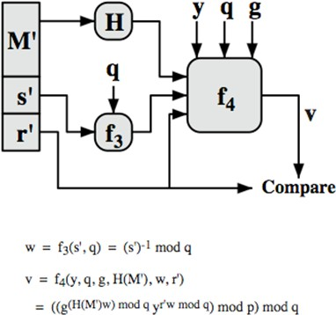
DSA Signature Verification
To verify a signature, recipient computes:
w = s⁻¹ mod q
u1= [H(M)w ]mod q u2= (rw)mod q
v = [(g^{u1} y^{u2})mod p
]mod q
If v=r then signature is verified

Slide 17
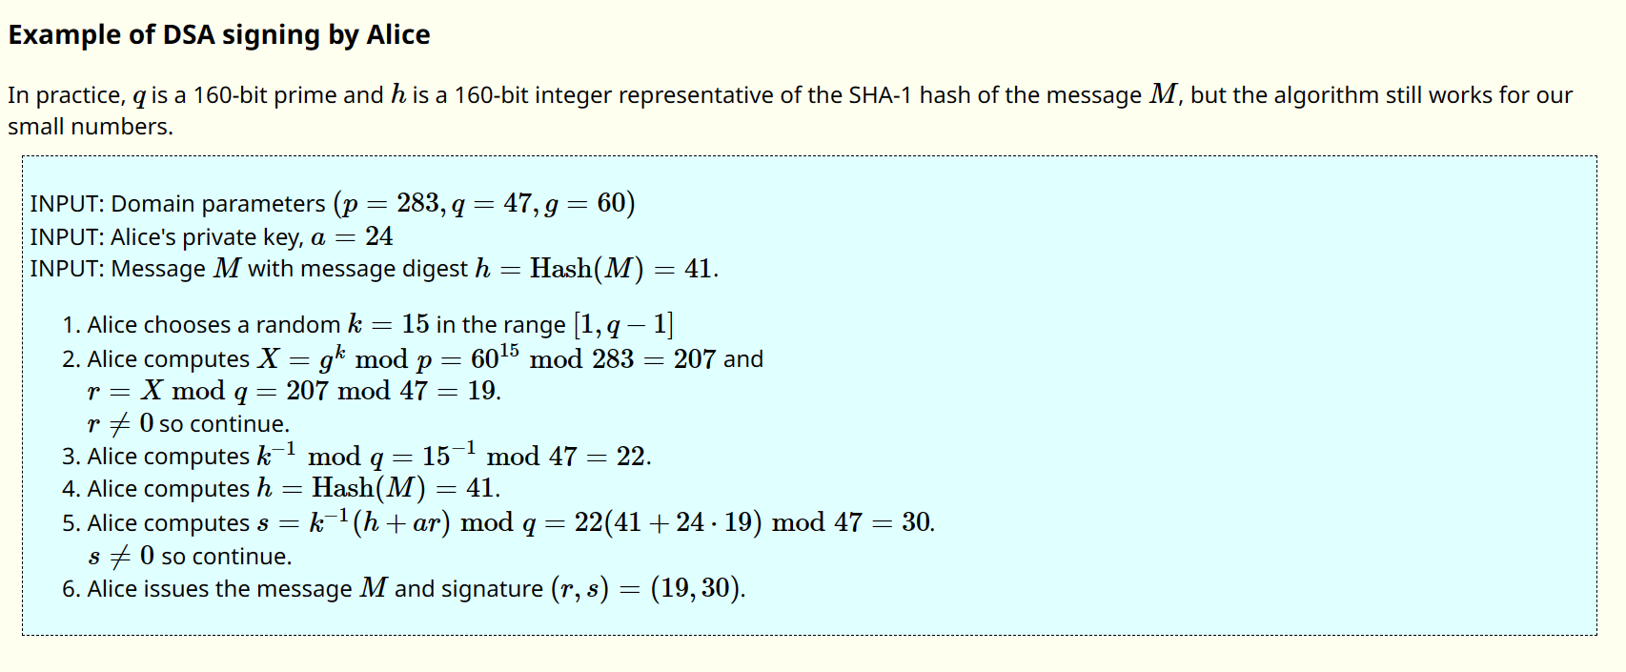

Slide 18
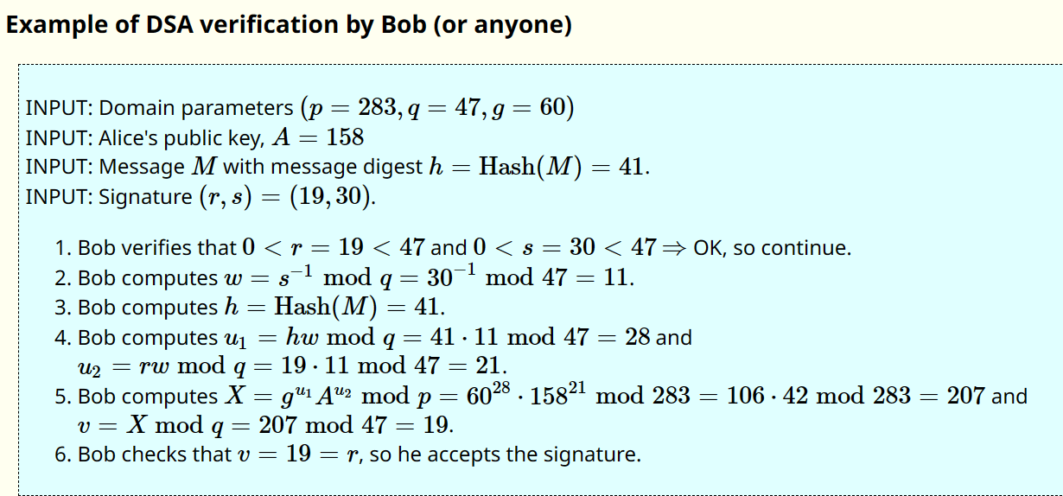

Slide 19
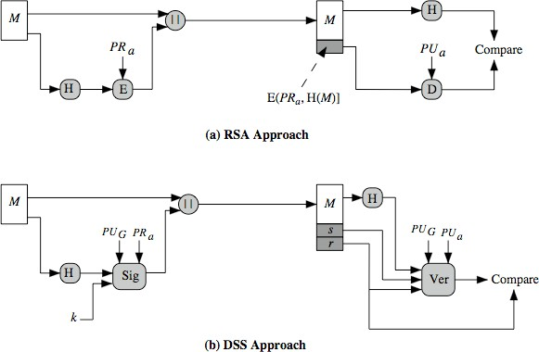
DSS vs. RSA Signatures
PU_{G} = Global Public Key k = Per message secret key

Slide 20

Summary
Digital signature depends upon the message and some information unique to the signer to prevent forgery and denial. Anyone should be able to verify.
ElGamal/Schnorr/DSA signatures use a per-message secret key and are based on exponentiation
DSA produces a 320 bit signature

Slide 21
Homework 13
DSA specifies that if signature generation process results in a value of s=0, a new value of k should be generated and the signature should be recalculated. Why?
Suppose Alice signed a message M using DSA with a specific k value and then the k value was compromised. Can Alice still use her private key for future digital signatures?
Hint: Show that the private key of the signer can be easily computed in both of the above cases.

Slide 22
Person A wants to send a message to Person B. Both agreed to use SHA1 for obtaining the message digest. Let the generated message digest for the message be 4. Both agree on the public key components {p, q, h} as {23, 11, 7}. Person A selects his private key as 3. Let the pseudorandom integer k be 5. Demonstrate the step-by-step calculation for the following:
Generate the digital signature using DSS.
Signature Verification

